Slide 1
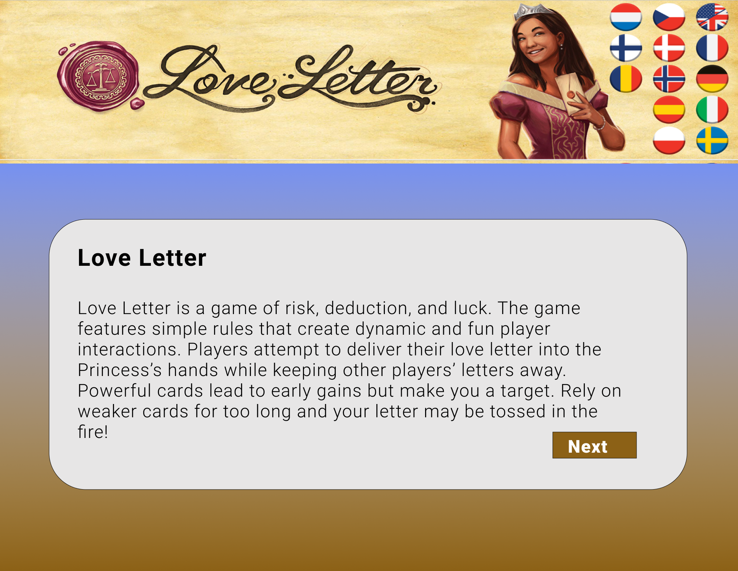

Project Name: LoveLetter Game | Page Title: Home page | Page Number:1
 |  | Graphic Info: Home page ,End user will click Next button to navigate to adding player name window.
 |  | Navigate to: Navigate to the adding player name window

Slide 2
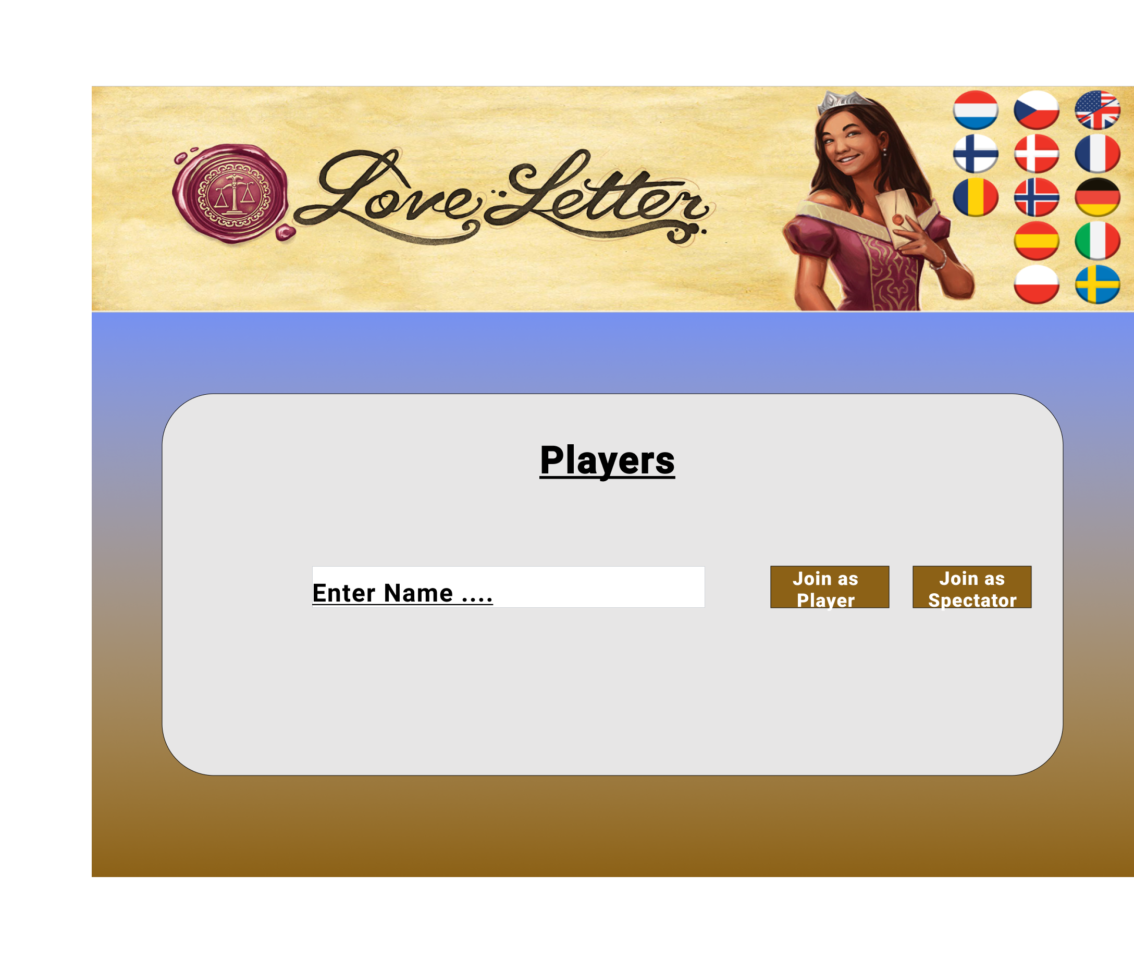
Project Name: LoveLetter Game | Page Title: Adding Player name | Page Number:2
 |  | Graphic Info: Adding player Name ,End user will type name on the text box, player will have an option to join as player or spectator
 |  | Navigate to: Post name entered ,player will navigate to player list window

Slide 3
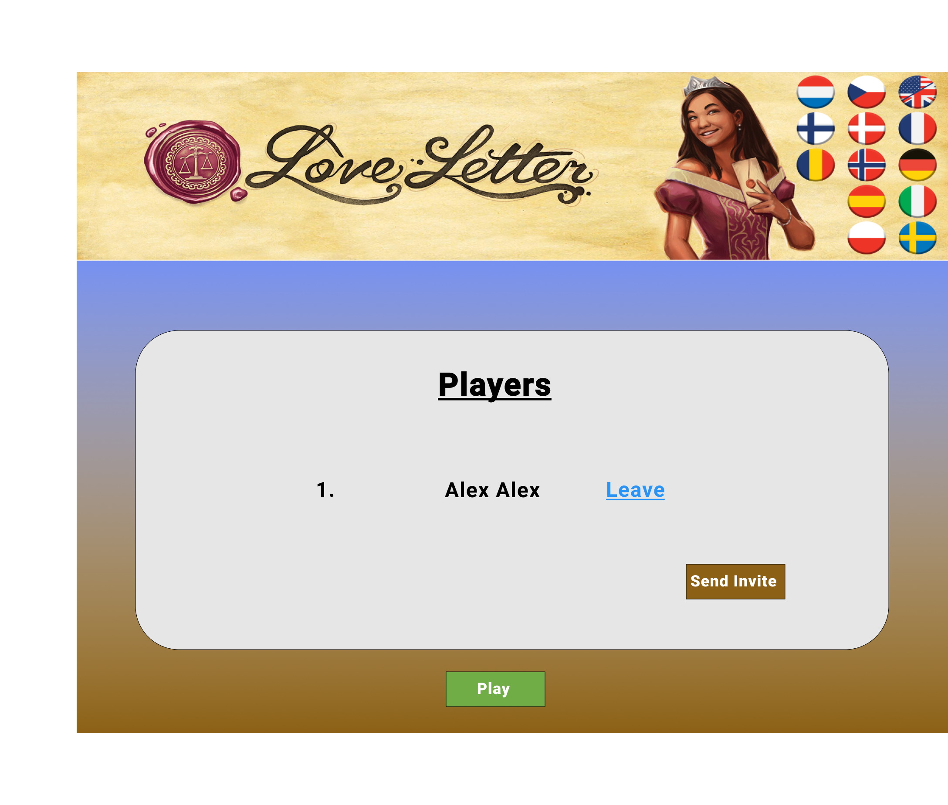
Project Name: LoveLetter Game | Page Title: PlayerList | Page Number:3
 |  | Graphic Info: Player name will display in the list ,Player will have options: leave the game Send Invite Post user confirmed name displayed ,User will enable to play the game.
 |  | Navigate to: Player will navigate to the Game window.

Slide 4
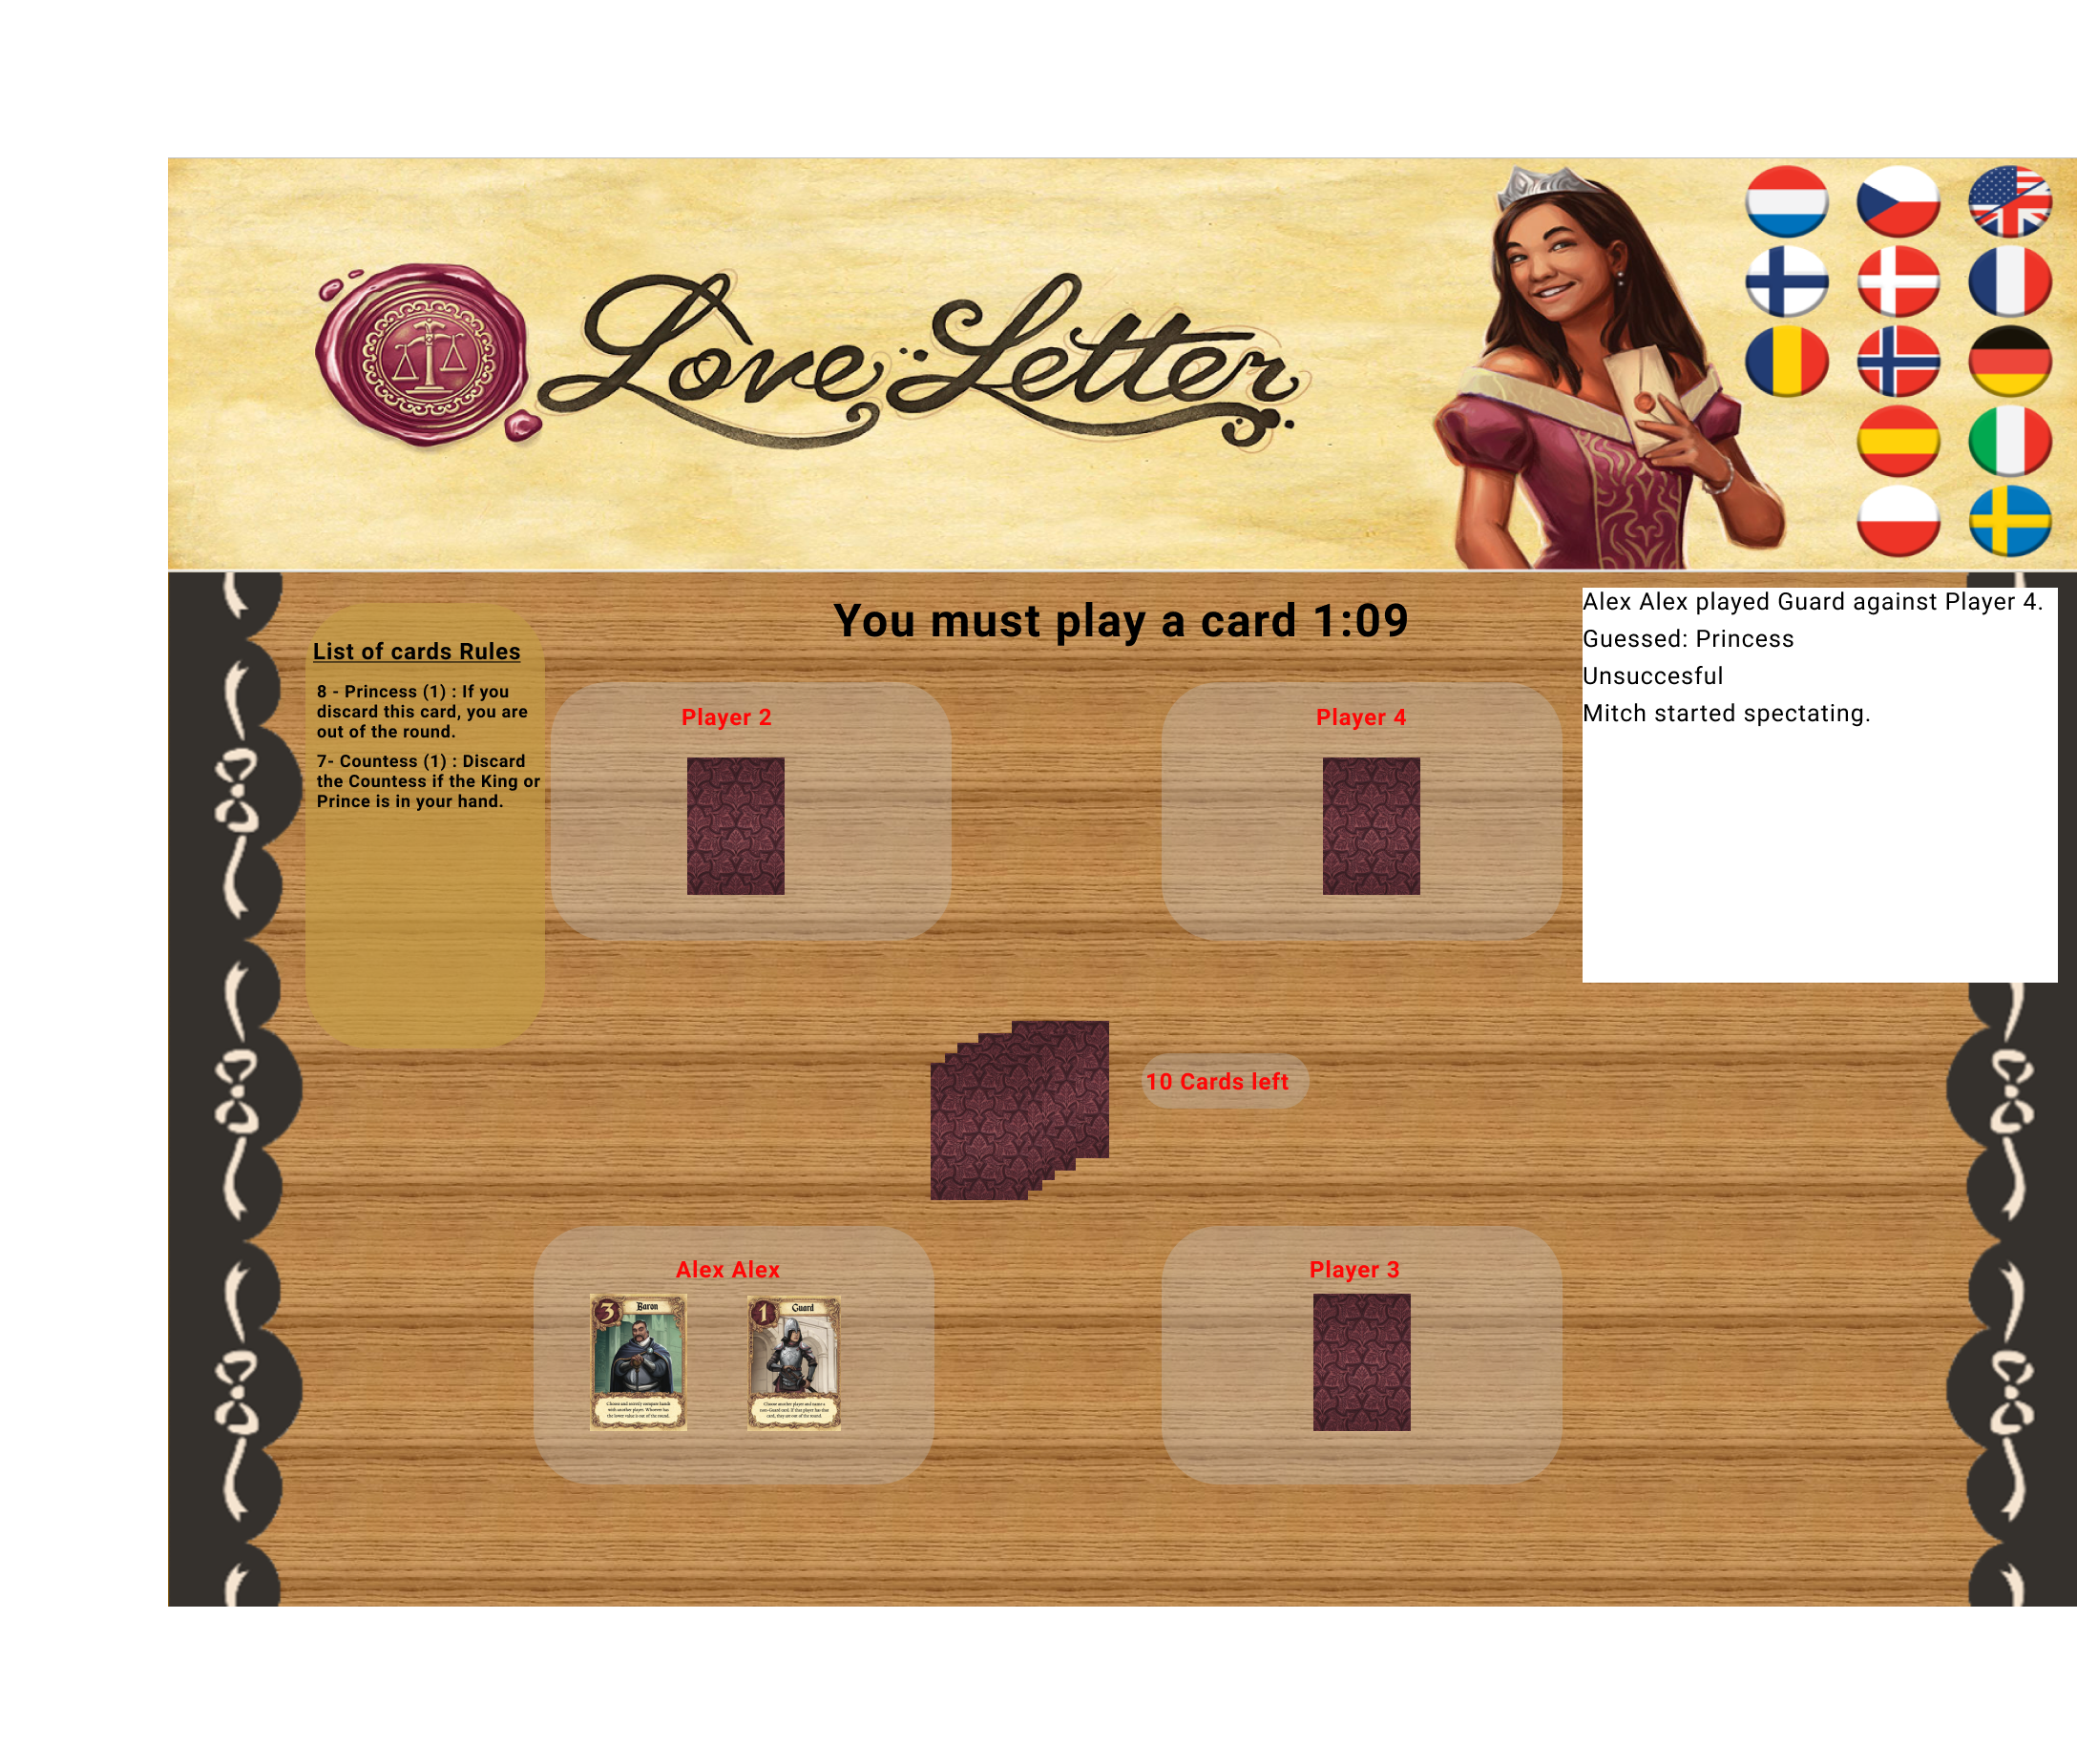
Project Name: LoveLetter Game | Page Title: Game (During the Game) | Page Number:4
 |  | Graphic Info:
 |  | Navigate to:

